Slide 1
Sets and Dictionaries
By
Anirudh K M
Analyst, Mobius Knowledge Services

Slide 2
Sets
A set is an unordered collection with no duplicate elements. Basic uses include membership testing and eliminating duplicate entries. Set objects also support mathematical operations like union, intersection, difference, and symmetric difference, says Python documentation.
Curly braces or the set() function can be used to create sets. Note: to create an empty set you have to use set(), not {}; the latter creates an empty dictionary, a data structure that we discuss in the next section.

Slide 3
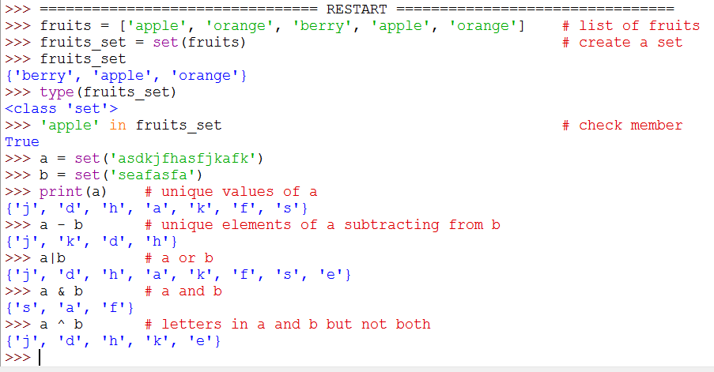
Illustration

Slide 4
Sets
Like other compound data types, we can lots of in built methods for sets too.
Few of them to name are
add
copy
difference
I leave that to you, to explore on those.

Slide 5
Dictionaries
Dictionaries are also sequence of elements which are indexed in a key value pair.
The dictionaries are enclosed in a flower brackets.
Its important to note that the key values must not have ANY association with any mutable objects.

Slide 6
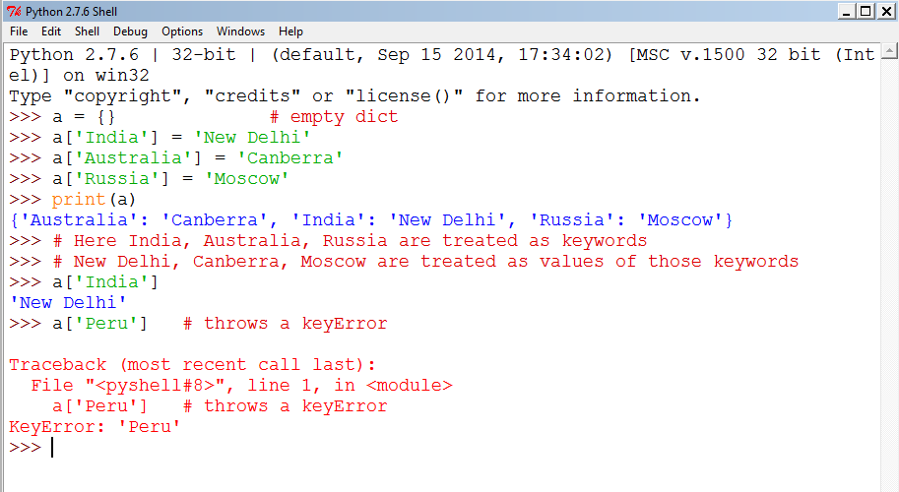
Illustration

Slide 7
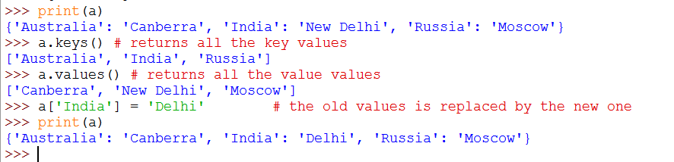
Illustration on inbuilt methods

Slide 8
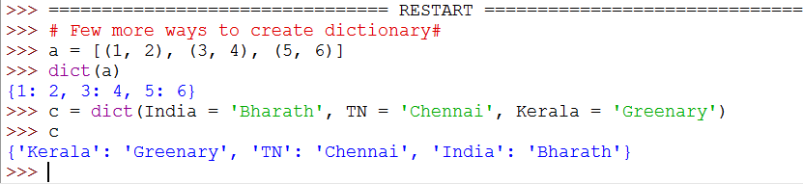
Ways of creating dictionaries

